Slide 1
Swiggy Analysis
-YASHWANTHINI AISHWARIYA B

Slide 2
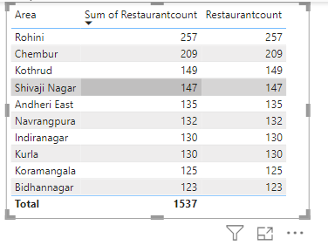
Task 1: Top 10 area with restaurants
The area which has highest no. of restaurant is Rohini
The area which has lowest no. of restaurant is Bidhannagar

Slide 3
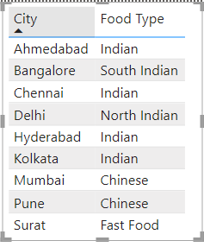
Task 2: Most Popular Food Types Served by Swiggy Restaurants in Each City
People in India mostly like to have Indian dishes

Slide 4
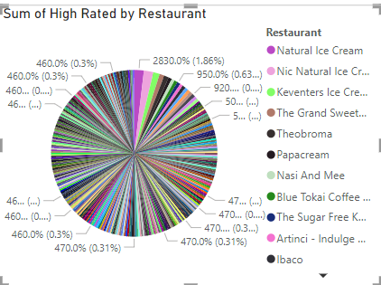
Task 3: Top rated Swiggy restaurants

Slide 5
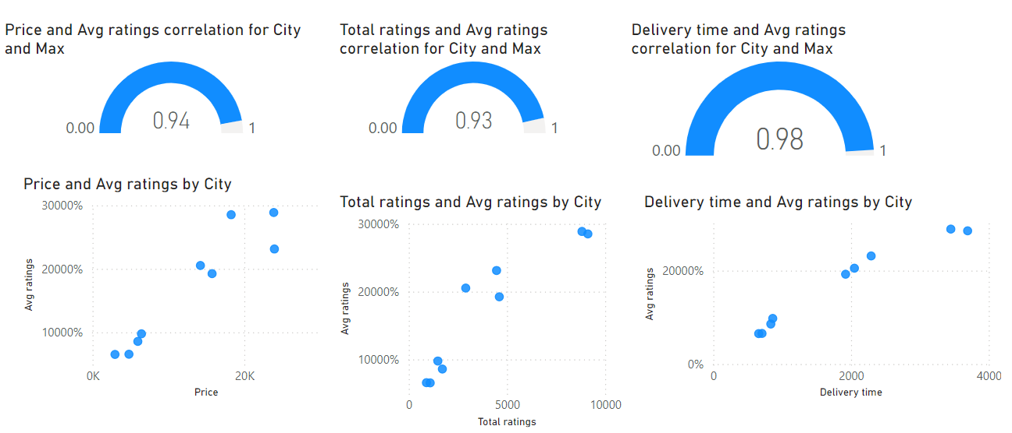
Task 4: Correlation of factors affecting average ratings
Price Vs Average rating has positive correlation
If Price increases then average rating tend to increase
Total rating Vs Average rating has positive correlation.
This indicates that restaurants with a higher number of ratings generally have better average rating
Delivery time Vs Average rating has very strong positive correlation
The restaurants with faster delivery times tend to have average ratings

Slide 6
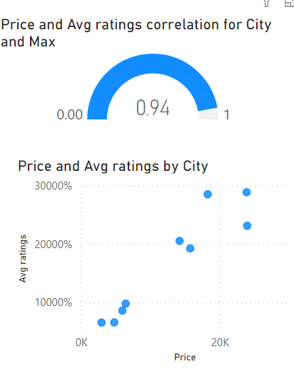
Task 5: Correlation between restaurant price and average rating
It has a very strong positive correlation
The price increases, the average ratings tend to increase

Slide 7
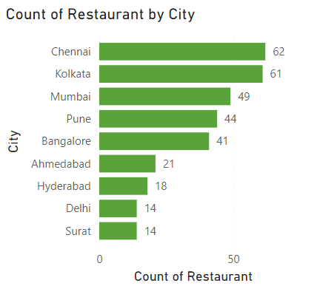
Task 6: City wise restaurant count
Chennai and Kolkata has the highest count
Delhi and Surat has the lowest count

Slide 8
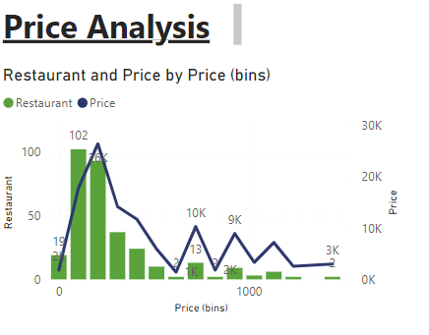
Task 7: Price Analysis
The restaurants in lower price bins indicate the higher demand which leads the highest delivery time
Lower price ranges likely have higher competition locally

Slide 9
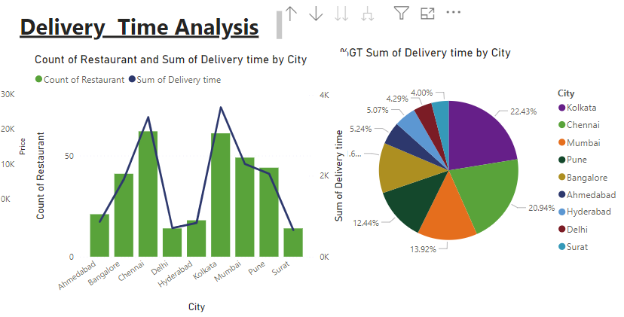
Task 8: Delivery time Analysis
Cities with higher number of restaurants experiences longer delivery time due to demand and logistics challenges
This chart helps to optimize the routes and identify the areas for improvement in delivery time management

Slide 10
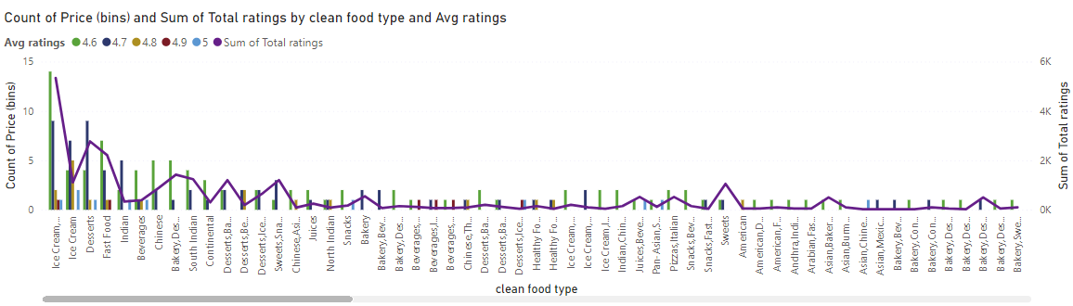
Task 9: Cuisine Analysis
Food types with higher average ratings might be perceived as high quality or more populat

Slide 11
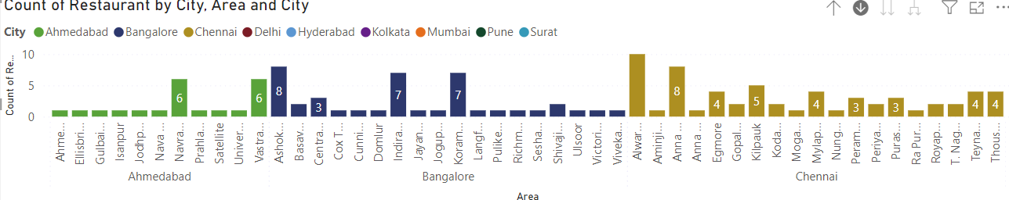
Task 10: Area wise restaurant analysis
High demand exists in area with higher concentration of restaurants

Slide 12
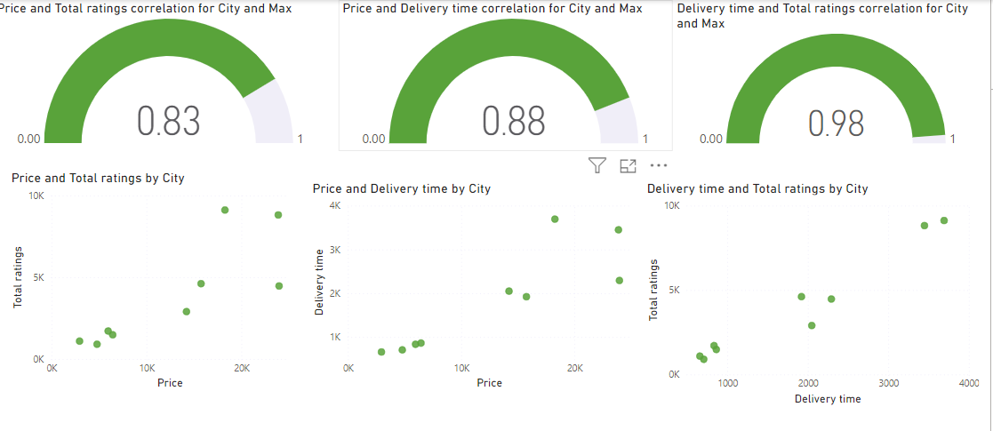
Task 11: Correlation Analysis
All the factors shows positive correlation
High priced restaurants tend to have a higher number of total rating
Restaurant with high price tend to have longer delivery time
Restaurants with longer delivery time tend to have a higher number of total ratings

Slide 13
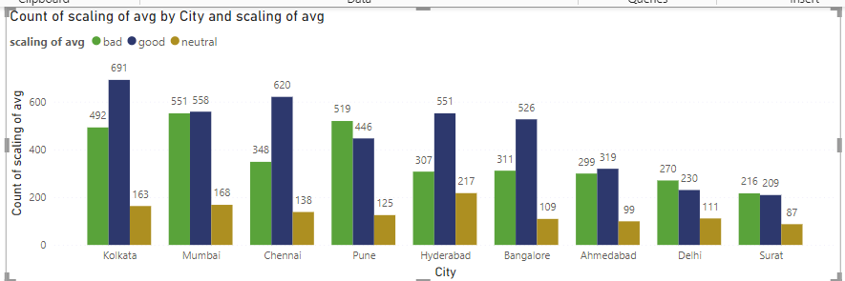
Task 12: Customer Feedback Analysis
Cities with a higher count of “good” feedback likely have higher customer satisfaction levels

Slide 14
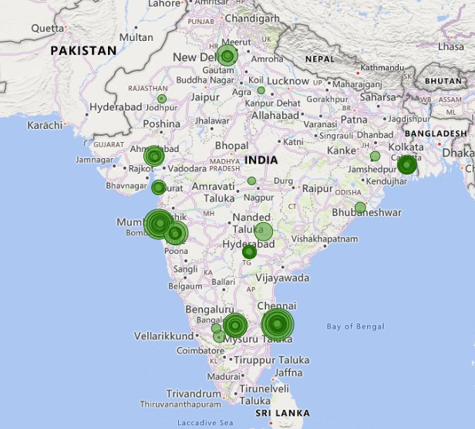
Task 13: Geographical Mapping
This chart shows the sum of price in each location
The darker shows the highest price and the light shows the less price

Slide 15
Task 14: Business Recommendations
Restaurant in higher price ranges may cater to niche market
Factors like traffic, population and restaurant distribution within the city could influence delivery times
Analyze price sensitivity for different food types and areas to optimize the pricing
Competitive landscape for different food types helps in framing target market and pricing strategies
Cities with a higher proportion of “bad” and “neutral” feedback might need to focus on improvement

Slide 16
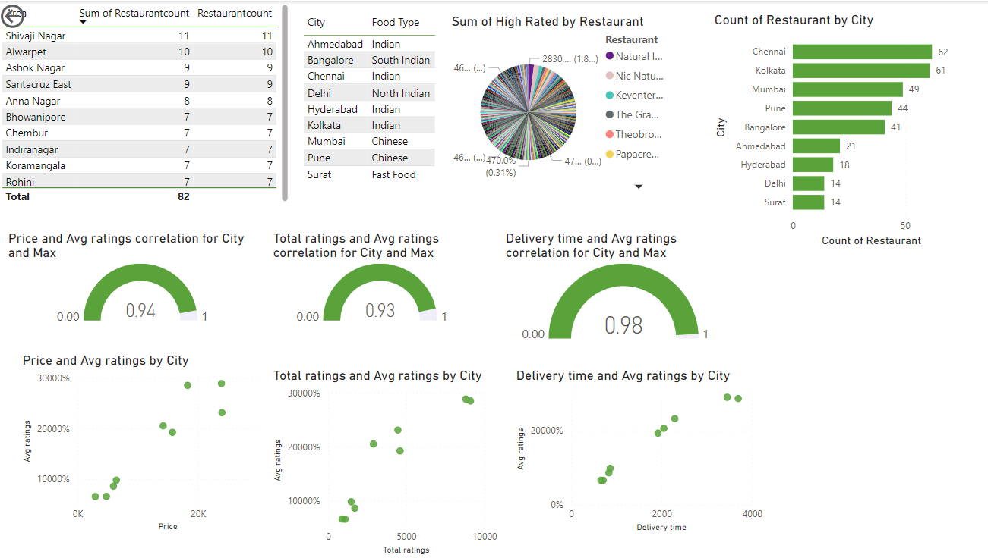
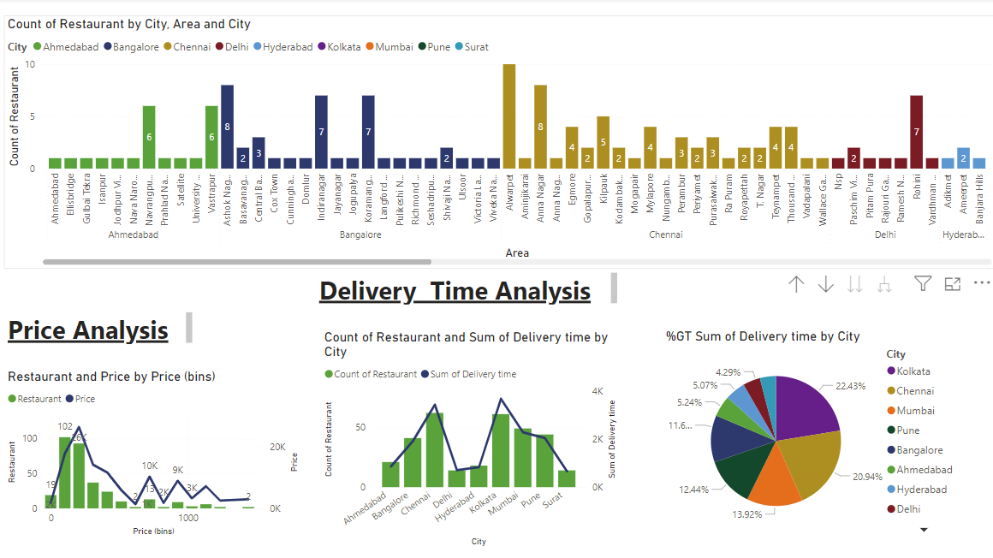
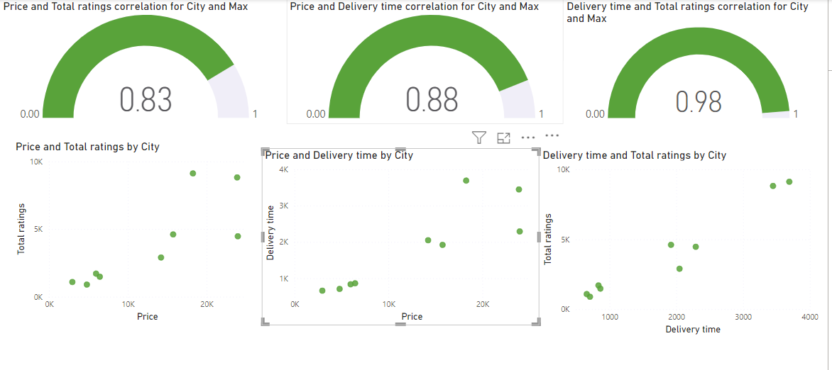
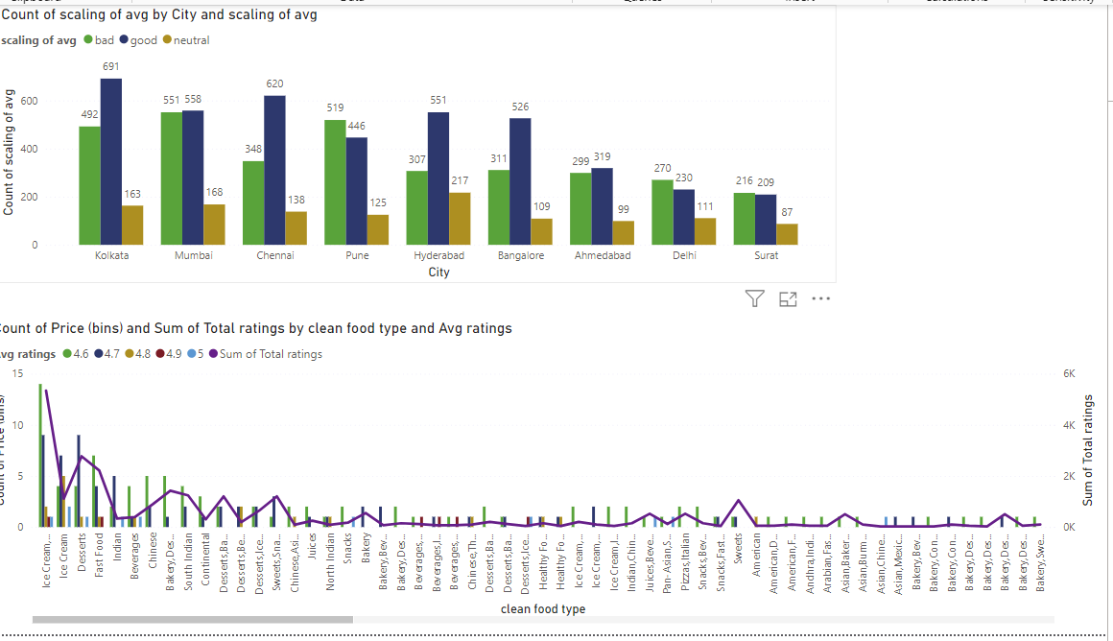
Dashboard

